Slide 1
Daily Math Review 2nd Grade
February 6, 2013
2:30 – 3:45pm

Slide 2
Professional Development Norms
Sign in today.
Attendance is required.
Be on time.
Be prepared – bring all requested items.
Limit side conversations.
Avoid using computers or cellphones.
Avoid working on other tasks.
Be respectful of facilitator + peers.
Participate!

Slide 3
Professional Development Credit
To receive one Heartland or Drake credit…
Attend all eight sessions (4 Literacy + 4 Math).
Attendance requires every teacher to stay until 3:45pm.
Registration details listed on the agenda.
Deadline for registration is May 22nd.
You may register any time between now and May 22nd.
Suggestion: Wait until closer to May 22nd to register because if you register and then miss a session you will not receive credit nor be reimbursed.

Slide 4
Professional Development Objectives
Teachers will receive an overview of Daily Math Review for 2nd Grade.
Teachers will view a video of Daily Math Review in.
Teachers will receive a guide of how to implement Daily Math Review in their classrooms.
Teachers will receive Daily Math Review examples and resources.
Teachers will create one cycle of Daily Math Review from start to finish.

Slide 5
Daily Math Review: District Expectation
By the end of second semester, ALL grade K – 2 teachers will implement Daily Math Review, according to district guidelines.

Slide 6
Daily Math Review: The Purpose
What is the Purpose of Daily Math Review?
The purpose of Daily Math Review is simply that: REVIEW.
It is not to instruct students on new concepts or skills.
Math Review is a time in the math block to discuss with students reasonableness of answers and estimation.
Perfect opportunity to help students develop computational strategies and skills.

Slide 7
Daily Math Review: The Rationale
What is the Rationale to Implementing Daily Math Review?
Number sense is essential to student success with computational skills.
Provides students with effective practice and allows them access to timely and specific feedback.
Gives students a daily opportunity to reflect on their progress which increases their responsibility for learning.
Helps students become aware of their individual mistakes or misunderstandings which increases their chance for math success.
Teachers are able to regularly review and assess students’ computational skills.
Teachers become aware of students’ common mistakes and misunderstandings so that they can appropriately modify and adjust instruction.

Slide 8
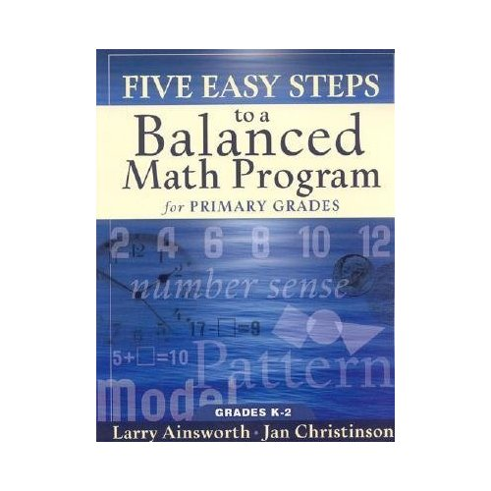
Daily Math Review: The Framework
Where Can I Find More Information About Daily Math Review?
Daily Math Review is one component of The Five Steps to a Balanced Math Program.
The Balanced Math Components include:
Daily Math Review + Mental Math
Problem Solving
Conceptual Understanding
Fact Fluency
Formative Assessment
Future District PLC Meetings will focus on the Balanced Math Framework.
Every building has a copy of this book for Primary Grades. Check with your instructional coach.

Slide 9
Daily Math Review: The Common Core
How Does Daily Math Review Fit with the Expectations of the Common Core?
Des Moines Public Schools Mathematics Expectation:
All students will demonstrate mastery of the RIGOROUS Common Core Standards for Mathematics.
According to the Common Core…
RIGOR
is a BALANCE of…
Conceptual Understanding
Procedural Skills/Fluency
Application
Problem Solving
Daily Math Review
Problem Solving
Conceptual Unit
Mental Math
Formative Assessment
Fact Fluency

Slide 10
Daily Math Review: The Guide
The Setting
Students are sitting at their desks.
Students should be assigned a Daily Math Review partner.
Students should be sitting in close proximity to their partner.
Students should know what Daily Math Review “TIME” looks and sounds like. It will take some time to establish this routine.

Slide 11
Daily Math Review: The Guide
The Materials
Students should paper and pencil for DMR.
You may provide students with whiteboards/manipulatives, if you find them to be necessary and appropriate.
Use a projector or whiteboard to present the problems.

Slide 12
Daily Math Review: The Guide
The Problems
The teacher deliberately selects problems that represent different math standards that focus on student review and practice on variations of the same problems throughout a two week period.
1 – 3 problems:
Start small (1 problem) to establish routine.
Add up to 2 more problems as students become comfortable with the process.

Slide 13
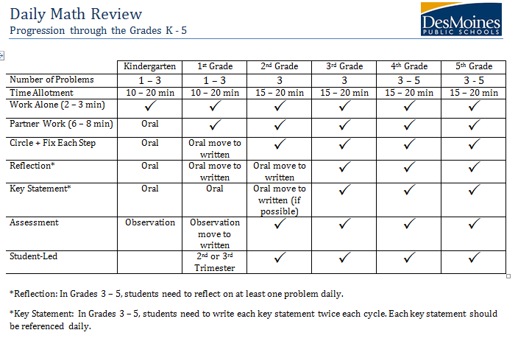
Daily Math Review: The Guide
The Progression

Slide 14
Daily Math Review: The Guide

Slide 15
Daily Math Review: The Guide

Slide 16
Daily Math Review: The Guide

Slide 17
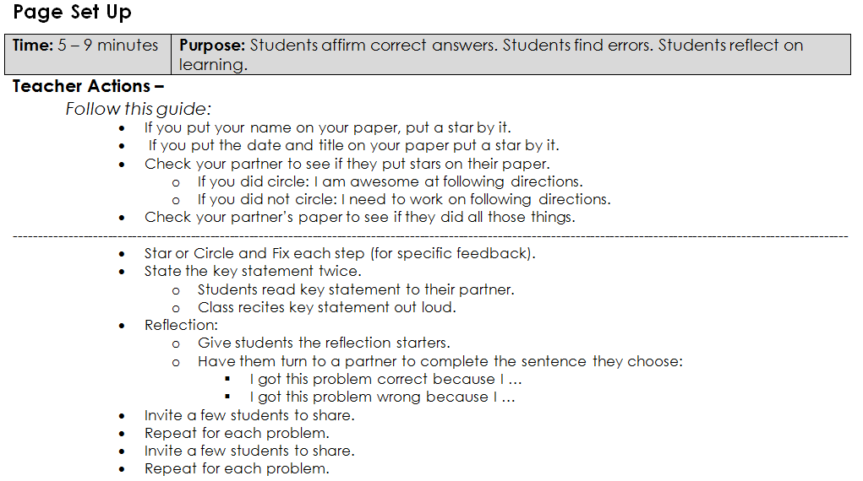
Daily Math Review: The Guide

Slide 18
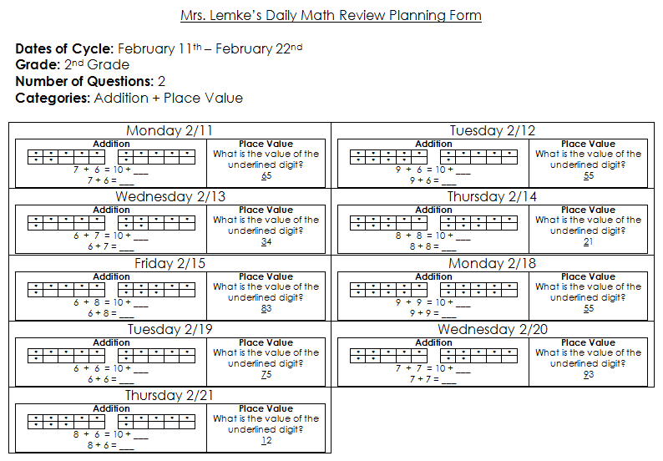
Daily Math Review: The Cycle
Notice the two different categories each day.
Notice that the type of question remains the same each day (Repeated Reasoning).

Slide 19
Daily Math Review: The Assessment
A cycle is 9 days of practice and on the 10th day, the teacher will assess.
For the assessment – there will be three problems per category.

Slide 20
Daily Math Review: The Assessment
Teacher Analysis of the Assessment
If close to 90% of the class has mastered the category (i.e. Place Value – 10s) you can move on to a new category (i.e. Decomposing Numbers).
If 90% has not mastered the category (i.e. Place Value – 10s) you will put them in another cycle for two more weeks.
If after 2 – 3 cycles, 90% of the students still are not mastering the concept, take the category out. This informs the teacher that the category is not review and needs to be taught explicitly.

Slide 21
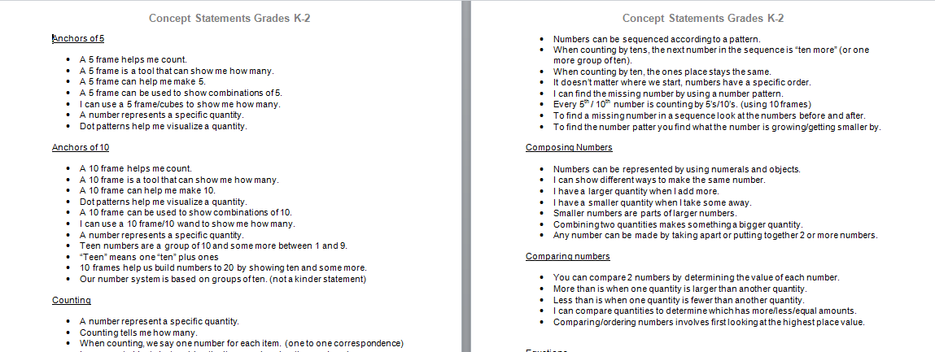
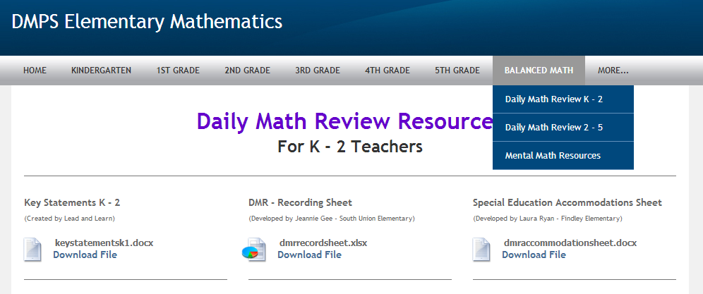
Daily Math Review: Resources
Key Statements
Key Statements are available on the elementary math website:
http://elementarymath.dmschools.org/

Slide 22
Daily Math Review: Video Example
Video Example : Second Grade Findley Elementary
Recorded in November after the students have been doing DMR since the start of the year.

Slide 23
Daily Math Review: Work Time
Expectation for March 6th District PLC Meeting:
All K – 2 teachers will run a cycle of Daily Math Review.
Use the rest of the time to create a cycle with your team.
1 – 3 categories
9 questions per category
1 key statement per category
2 reflection starters
1 assessment = 3 questions per category

Slide 24
Daily Math Review: Feedback
Notecard:
(Use any or all of the options below)
I am excited about…
Next time I would like…
Something I find challenging…
I wonder about…
I would like more information on…
I really enjoyed…

