Slide 1
District PLC Meeting Elementary
September 18. 2013
2:30 – 3:45pm

Slide 2
Agenda
2:30pm Welcome & Introductions
2:40pm Establishing a Purpose for Our Work
2:45pm Elementary Literacy Updates Website, Assessments Update
2:55pm Elementary Math Framework
3:20pm HealthTeacher.Com Reminder on how to access the site; New Go Noodle options!
3:40pm Wrap-Up and Exit Slip
3:45pm Dismissal

Slide 3
Welcome and Introductions

Slide 4
The Purpose of the District PLCs
Support the implementation of our common district initiatives
Provide teachers with an opportunity to share ideas and collaborate with colleagues from around the district

Slide 5
Norms
Be on time – every time
Be prepared – bring back requested materials
Be present
No side conversations
Avoid using your computer or cell phone
Avoid working on other tasks – stay focused on the topic at hand
Be respectful of your peers and the facilitator
Participate!

Slide 6
Logistics
Our sessions will begin promptly at 2:30pm and will dismiss at 3:45pm
Parking
Restrooms/Facilities
Table Assignments
Notes:
Table Assignments- rationale for why we may sit in different groups

Slide 7
Attendance
Attendance will entered into Infinite Campus. If you are marked absent, you will receive an automated message from Infinite Campus. If you receive this message erroneously – please contact me (your facilitator) right away!
Heartland AEA credit will NOT be offered for our PLC Sessions this year.

Slide 8
Getting to Know You…
We will work together, as a Professional Learning Community, for 8 sessions throughout the school year.
Site, room, and time will stay the same for all 8 sessions.
Get to know you activity…
Name
School
Position

Slide 9
Literacy Update
Website- What’s New?

Slide 10
Curriculum Websites
www.elementaryliteracy.dmschools.org
www.elementarymath.dmschools.org

Slide 11
New to Literacy Website
Passage possibilities for CFA creation linked to Grades 2-5 Assessment page
Student profile sheets to be used during conferences uploaded to the K-5 Assessment Page
These will need to be printed at the building.
Many components can be typed in prior to printing.

Slide 12
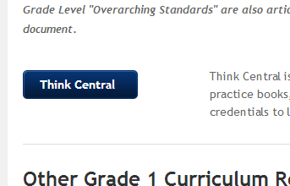
New to Literacy Website
Think Central button has been added to the Curriculum Guide page for all grade levels.
This link will take you directly to the Think Central login.

Slide 13
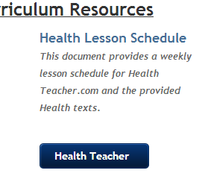
New to Literacy Website
Health Teacher button added under the link to the Health Lesson Schedule on the Curriculum Guides page for each grade level

Slide 14
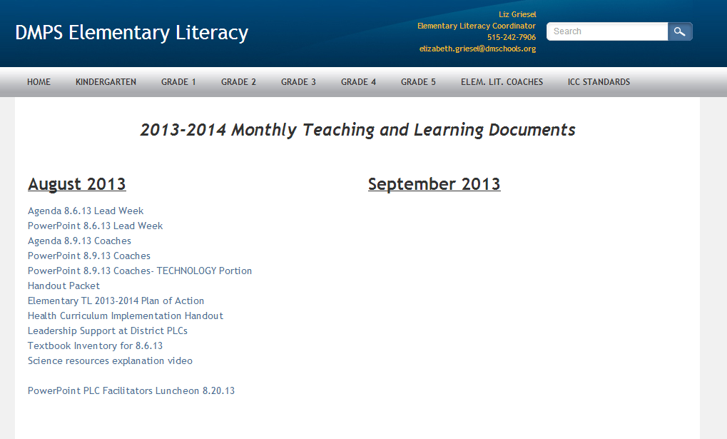
Literacy Website
Links to these PLC powerpoints and other documents under “Elem. Lit. Coaches” tab

Slide 15
Website Resources
Anything to add to the websites?
Feedback?
Teacher-created resources to share?
Send ideas and resources to anna.taggart@dmschools.org, elizabeth.griesel@dmschools.org, or to your coach.
Notes:
Email Liz, Anna or your coach ideas on resources that we should add to the websites. We also want to keep adding to our archive of teacher materials so send those, and Anna and Liz will update the website with those resources so teachers can share ideas, activities, and documents across all schools.

Slide 16
Literacy Update
Assessments

Slide 17
Assessments Update
Grades 1-5 Comprehensive Standards Assessments (midyear and end of year) will be posted in draft form on the website by Monday, September 23rd
Please look over and send feedback to Liz Griesel (elizabeth.griesel@dmschools.org) or to your building coach
Final Drafts will be posted by…
OCTOBER 11th!

Slide 18
Elementary Math Framework
Notes:
Today we are going to review the components to the Elementary Math Framework and outline some of the district expectations, as well as some strategies to fit all of the components into your math block.

Slide 19
DMPS: Mathematics Framework 60 – 90 minutes daily
Daily Math Review
Review of prerequisite skills or previously instructed content that was not mastered.
Mental Math
3 – 5 multi-step questions completed daily. Questions are aligned with what is currently being taught during core instruction.
Whole Group Instruction
Conceptual Understanding, Procedural Knowledge and Application Instruction
Small Group Instruction
Scaffold differentiated instruction that occurs 3-5 times per week
Fact Fluency Practice
Fact practice to build automaticity that occurs daily (Grades 2-5)
Notes:
To start off – we are going to review the components of the math framework. This information comes directly from your “designing your instructional day” form that you have in your curriculum resources.
CLICK
The first component is Daily Math Review which we spent a large majority of our District PLC time last year learning about. Daily Math Review is a review of prerequisite skills or previously instructed content that was not mastered.
CLICK
The second component is Mental Math. We did spend some time with this last year, but will continue to touch on this year. With Mental math teachers will give students 3 – 5 multi-step questions to be completed daily.
CLICK
Whole Group Instruction is the next component which needs to include a balance between conceptual understanding, procedural knowledge and application instruction.
CLICK
Small group Instruction should be scaffolded, differentiated instruction that occurs 3 – 5 times per week.
CLICK
The last component is Fact Fluency Practice. Fact Fluency practice builds automaticity and should occur daily.

Slide 20
Mathematics framework: A Review of Daily Math Review
Notes:
Let’s dig a little deeper into each of the components. The first component will be the review of daily math review…

Slide 21
Daily Math Review: District Expectation
10 – 20 Minutes Daily
ALL grade 1 – 5 teachers will implement Daily Math Review, according to district guidelines, at the start of the school year.
ALL kindergarten teachers will implement Daily Math Review, according to district guidelines, by the start of the second semester.
Notes:
The current district expectation is that ALL grade 1 – 5 teachers will implement DMR, according to the district guidelines (which we soon review) at the start of the school year.
Kindergarten differs slightly with the expectation being that ALL kindergarten teachers will implement Daily Math Review, according to district guidelines, by the start of second semester.
That by no means that kindergarten teachers have to wait until second semester to start. You can start any time you, you teaching partners, your students are ready.

Slide 22
Daily Math Review: The Purpose
What is the Purpose of Daily Math Review?
The purpose of Daily Math Review is simply that: REVIEW.
It is not to instruct students on new concepts or skills.
Math Review is a time in the math block to discuss with students reasonableness of answers and estimation.
Perfect opportunity to help students develop computational strategies and skills.
Notes:
It is important to review what the purpose of why we do DMR…
The purpose is simply review and not to instruct on new concepts or skills.
Math review is a great time to discuss reasonableness of answers and estimation.
In the past, the feedback in math was always, my students did not master several concepts on the last unit assessment, but there is not any time to reteach because we have to move on to the next unit. Math Review allows 10 – 20 minutes a day to review!

Slide 23
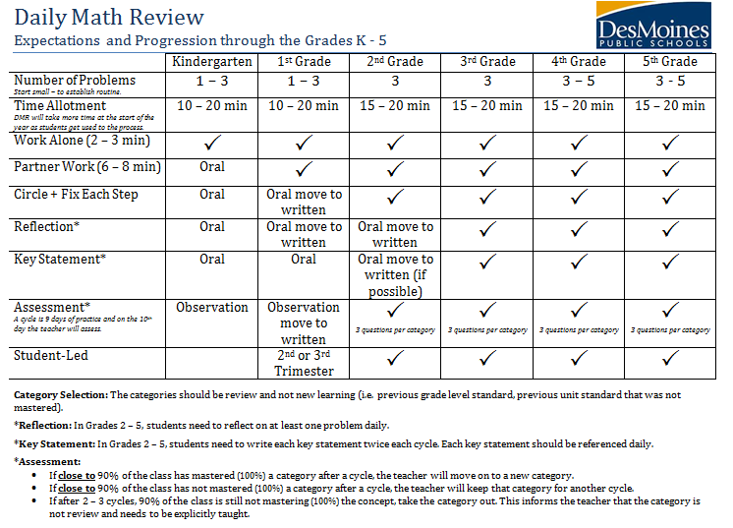
Daily Math Review: District Expectations
Notes:
You have a handout that outlines the District Expectations and the Progression of DMR from grades k – 5.
In a minute you will have a few minutes to review this by looking at your grade level, the progression across grade levels, as well as the notes at the bottom.
After you are finished reviewing it – you will turn to an elbow partner… CLICK TO NEXT SLIDE

Slide 24
Daily Math Review: Partner Reflection
Turn to an elbow partner and discuss your current implementation level with Daily Math Review in accordance with the district expectations.
Positives
Challenges
Next Steps
Notes:
And discuss not only this document, but also your current implementation level with DMR in accordance with the district expectations. Think of some positives, challenges, and next steps…
If you have a question for Anna Taggart, the elementary math coordinator, feel free to use one side of the notecards which are your exit slips and write your down your question. It does help to put contact information for Anna to get back to you.

Slide 25
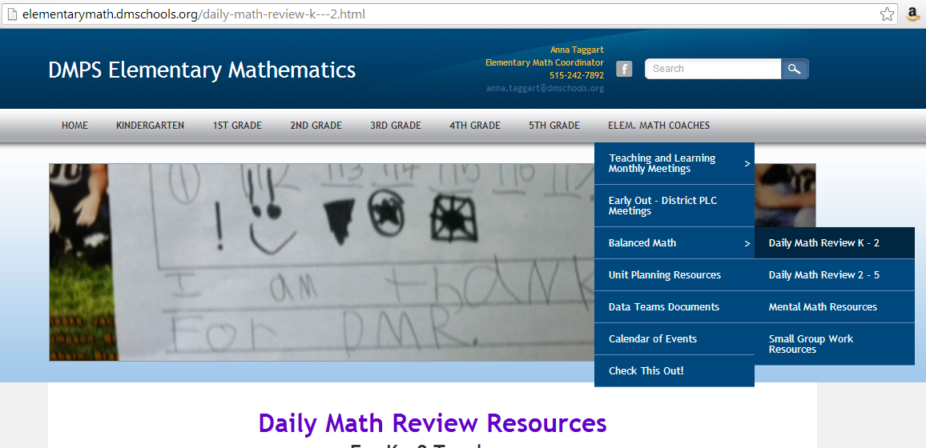
Daily Math Review: Resources
The Elementary Math Website has resources available for Daily Math Review:
http://elementarymath.dmschools.org/
Key Statements
Recording Sheets
Blank Cycle Forms
Partner – Sentence Starters
SPED Accommodation Sheet
Notes:
A reminder that there are resources available on the math website. The site is easy to remember: elementarymath.dmschools.org
To find the resources – hover over the CLICK Elem. Math Coaches tab
CLICK Then over Balanced Math CLICK which will give you K-2 resources and 3-5 resources.
It would not hurt to look at both pages as many resources could be used for all grade levels.
Some of the resources include CLICK key statements, recording sheets, blank cycle forms, partner sentence starters, and SPED accommodation sheets
If you have other resources that you use that would be useful to others feel free to send them to anna taggart to post.

Slide 26
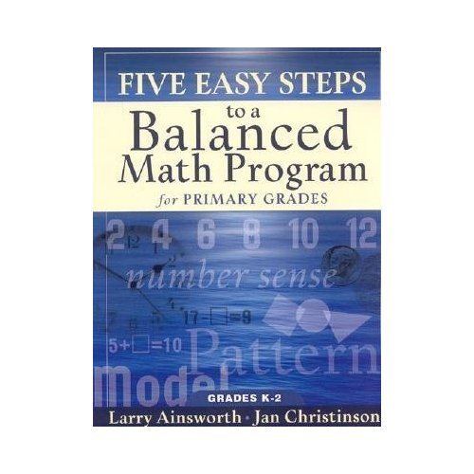
Daily Math Review: The Framework
Where Can I Find More Information About Daily Math Review?
Daily Math Review is one component of The Five Steps to a Balanced Math Program.
The Balanced Math Components include:
Daily Math Review + Mental Math
Problem Solving
Conceptual Understanding
Fact Fluency
Formative Assessment
On the October 25th EQ PD Day – an afternoon session will be offered for new teachers or teachers who need more assistance with Daily Math Review at Phillips Elementary.
Every building has a copy of this book for Primary Grades. Check with your instructional coach.
Notes:
If you are looking for more information – DMR is one component of The Five Steps to a Balance Math program. Each building should have a copy of the Five Easy Steps to a Balanced Math Program which should provide you with more information.
CLICK
Also on October 25 EQ PD Day – there will be an afternoon session offered for new teachers or teachers who need more assistance with DMR at Phillips Elementary.

Slide 27
Mathematics framework: A Review of MENTAL MATH
Notes:
Moving on to a review of Mental Math.

Slide 28
Mental Math: District Expectation
1 – 5 Minutes Daily
ALL grade K – 5 teachers will incorporate Mental Math into their classrooms daily.
Notes:
The district expectation is that all grade K – 5 teachers will incorporate mental math into their classroom daily.

Slide 29
Mental Math: The Purpose
What is the Purpose of Mental Math?
The purpose of Mental Math is to be able to calculate and estimate quickly, using number sense.
Notes:
The purpose is to give students practice in calculating and estimating quickly, using number sense which is a life skill.
You will find students really enjoy mental math time.

Slide 30
Mental Math: The Logistics
The problems used should be multi-step.
The problems need to be aligned to the current unit of study.
Mental Math should be quick (3 – 5 problems daily).
It can be completed any time throughout the school day and does not need to be done during the math block.
Mental math can be completed during a transition period, but it is helpful when students can write down their answers.
Many teachers have “Mental Math Time” for 2 minutes right after Daily Math Review.
Notes:
Let’s talk logistics…
The problems should be multi-step and also aligned to current unit of study. It is important that the questions have purpose – so if you are in a geometry unit – the mental math questions should geometry focued.
Mental math should be quick: 3-5 questions daily which should only take 1 – 5 minutes.
CLICK
It can be completed at any time the school day and does not need to be done during the math block. It can be done during a transition period, but it is helpful to have students write down their answers so that you can tell that they are doing the mental work.
Many teachers have Mental Math Time for two minutes right after DMR. They just have three blanks on page and have the students write down their three answers.

Slide 31
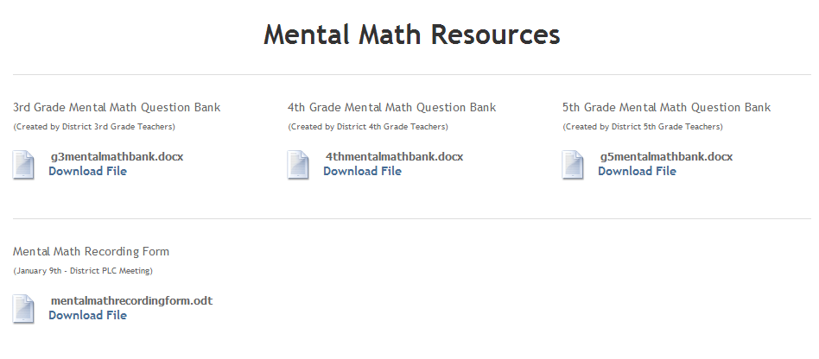
Mental Math: Resources
The Elementary Math Website has resources available for Mental Math:
http://elementarymath.dmschools.org/
Question Banks
Recording Form
Notes:
We do have resources available (mainly grade 3 – 5) on the math website.
You will go through the same steps as you did for DMR, but instead click on mental math.
So first CLICK on Elem math coach then CLICK Balanced Math CLICK Mental Math resources.
You will find question banks and recording forms.

Slide 32
Mathematics framework: Core Instruction
Notes:
The next component of the mathematics we are going to call Core Instruction.

Slide 33
Core Instruction: The Logistics
The Iowa Core outlines a need for balance between Conceptual Understanding, Procedural Knowledge, and Applications.
The Curriculum Guides indicate where the focus should be within each standard.
Curriculum Guides
Assessments
Expressions
Investigations
CGI
Fact Strategies (O’Connell + Fastt Math)
SMI + Quantiles.com
Notes:
Core instruction is directed by the Iowa Core. The Iowa Core outlines a need for balance between conceptual understanding, procedural knowledge and applications.
This years curriculum guides indicate where the focus should be within each standard.
CLICK
In order to be able to cover the Iowa Core Standards we need tools and resources.
In our math toolbox we have our curriculum guides, assessments, expressions, investigations, CGI, fact strategies, O’Connell, Fastt Math, SMI and Quantiles.com

Slide 34
Core Instruction: The Logistics
Curriculum Guides
Assessments
Expressions
Investigations
CGI
Fact Strategies (O’Connell + Fastt Math)
SMI + Quantiles.com
Whole Group Instruction
Small Group Instruction
Focused on the Iowa Core
Balance of Conceptual, Procedural, and Application.
Incorporation of Problem Solving and the Mathematical Practice Standards.
Notes:
With these tools we need to be able to plan for rigorous instruction in both (CLICK) whole group and small group instruction.
CLICK
Both Whole Group and Small Group Instruction should be focused on the Iowa Core, have a strong balance between conceptual, procedural and application knowledge and also incorporate of problem solving and the Mathematical Practice Standards – which we will spend our District PLC time together gaining a deeper understanding.

Slide 35
Mathematics framework: The Math Block
Notes:
That is a lot of information and one of the most frequent question is CLICK

Slide 36
Math Framework: The Math Block 60 – 90 minutes daily
Daily Math Review
Mental Math
How do I fit it all in one math block?
Whole Group Instruction
60 - 90 minutes
Small Group Instruction
Fact Fluency Practice
Notes:
How do I fit it all in one math block?
The math block needs to be at least 60 minutes long, but 90 is optimal.
You can look at the block with these five components in a very linear way. Every day in 75 minutes I do DMR, Mental Math, Whole Group Instruction, Small Group Instruction and 10 minutes of fact practice.
It is possible, but it is not the only way to look at your math block.

Slide 37
Math Framework: The Math Block 60 – 90 minutes daily
Daily Math Review
Core Instruction
Fact Fluency Practice
Mental Math
Whole Group Instruction
Small Group Instruction
Stand alone
10 -15 minutes daily.
Fastt Math
Xtramath
O’Connell Books
Teacher works with a small group on strategies.
Mental Math could be added to the end of Daily Math Review. It would add 1 – 5 minutes of extra time.
Whole Group Lesson
Mini-Lesson before small groups.
Does not need to happen every day.
3 – 5 times per week.
Based on student-needs.
Notes:
We are going to give you a few different ways you can structure your block of time.
CLICK
1st a teacher could pair Daily Math Review and Mental Math together. Mental math could be added to the end of DMR. It would add 1 – 5 minutes of extra time to that process.
CLICK
Then we move to Core Instruction
Under Core Instruction we have both CLICK whole group instruction and small group instruction.
CLICK
Whole group instruction could be a whole group lesson or perhaps a mini-lesson before small groups. It does not need to happen every day. For instance, if you did a whole group lesson on Monday, perhaps you move straight to small groups on Tuesday.
CLICK
There does need to be a balance of both whole and small group instruction, but small groups do not need to happen every day either. The expectation is 3 – 5 times per week based on student needs.
CLICK
Fact Fluency practice then could be a stand alone. Perhaps whenever you can get into a lab. It would be 10 – 15 minutes daily. Students could be working on Fastt Math, Xtramath, activities from the O’Connell Books, and the teacher works with a small group on fact strategies.

Slide 38
Math Framework: The Math Block 60 – 90 minutes daily
Daily Math Review
Core Instruction
Whole Group Instruction
Small Group Instruction
Daily Math Review could be completed at any time during the school day. It does not have to be part of the math block.
Mental Math
Fact Fluency Practice
Mental Math could be the “brain-warmer” to the whole group lesson.
Fact Fluency Practice could be small group learning task.
Notes:
Another way to look at a math block would be to have Daily Math Review be a stand alone and it could be at any time during the day and would not have to be completed during the math block.
CLICK
Then Core Instruction would include a mix of whole group and small group instruction (depending on the day).
CLICK
Mental Math could be paired with whole group instruction and could be the brain-warmer to the whole group lesson.
CLICK
Fact Fluency Practice could be a small group learning task completed be groups of students while the teacher is working with a different small group.

Slide 39
Math Framework: The Math Block
How do I fit it all in one math block?
There is flexibility in how you structure the math block.
The components that must happen daily include: DMR, Mental Math, Core Instruction and Fact Fluency Practice.
Notes:
The overall point of sharing different ways to set up your math time – is that there is flexibility in how you structure your math block.
The components that much happen daily include: DMR, Mental Math, Core Instruction and Fact Fluency Practice.

Slide 40
Elementary MATH DISTRICT PD 2013 - 2014
Focus: Mathematical Practice Standards + Problem-Based Tasks
Coming this October!
Notes:
To end the math portion here – the focus of the next 7 sessions will be on the Iowa Core Mathematical Practice Standards + Problem Based Tasks that you will be able to implement in your classroom.
In order to prepare for the October session you have an handout on the 8 Mathematical Practice Standards. It is only a front back, but please read over it and highlight questions or ideas or importance and bring it on October 30th!

Slide 41
Healthteacher.com

Slide 42
Health= 30 minutes
of Instruction Per Week
Notes:
This document is included with your curriculum documents. Don’t forget “HT” refers to lessons from HealthTeacher.com, and “B” refers to read aloud books. By now, your tubs should all be delivered and books sorted into the tubs. If you are still missing items, be sure to let your coach know so she can let our Health Curriculum Coordinator, Connie Sievers, know, and she make sure you get what you are missing.
Remember, if you have extra time, you can add in the optional/enrichment lessons and books listed at the bottom of each unit. Please be sure you only explore these options because other grade levels may be using the other HealthTeacher lessons or Read Aloud books during their units. By sticking to the options listed here, we will eliminate duplicating lessons across grade levels.

Slide 43
Notes:
Let’s take a minute to reacquaint ourselves with HealthTeacher.com since it may have been a while since you visited this resource or you might not have had a chance to explore it very much.

Slide 44
Activating your Health Teacher Account
Step 1: Go to www.HealthTeacher.com/activate.
Step 2: Enter Activation Code: desmoinesps-ia and click “Submit”
Step 3: Enter School Email Address & click “Continue”
Step 4: Enter User Information. Enter your First Name, Last Name and the Password dmpshealth. Select your School Name.
Step 5: Click “Submit” and explore HealthTeacher.com!
Notes:
If you haven’t activated your account, please do so now by following these directions.

Slide 45
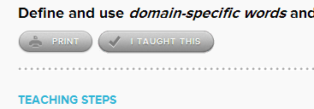
Signing In to your Health Teacher Account
Step 1: Go to www.HealthTeacher.com.
Step 2: Click “Log In” in right corner
Step 3: Enter dmschools email and your password* *click “forgot your password?” to reset via email
**Don’t forget to click the “I Taught This” button after you teach each health lesson on HealthTeacher.com
Notes:
If you have activated your account, you can go straight to HealthTeacher.com and clock “Log In.”

Slide 46
GoNoodle!
Click on GoNoodle link on HealthTeacher.com
Already logged in!
New feature: “Classes”– Set up your class by following the prompts on the screen.

Slide 47
Exciting Additions to GoNoodle!
1. Minutes –GoNoodle is retiring points and putting the emphasis on minutes.
Students see how much activity time they get throughout the day (or year!).
Soon GoNoodle will be making minutes more meaningful by adding a reward system.

Slide 48
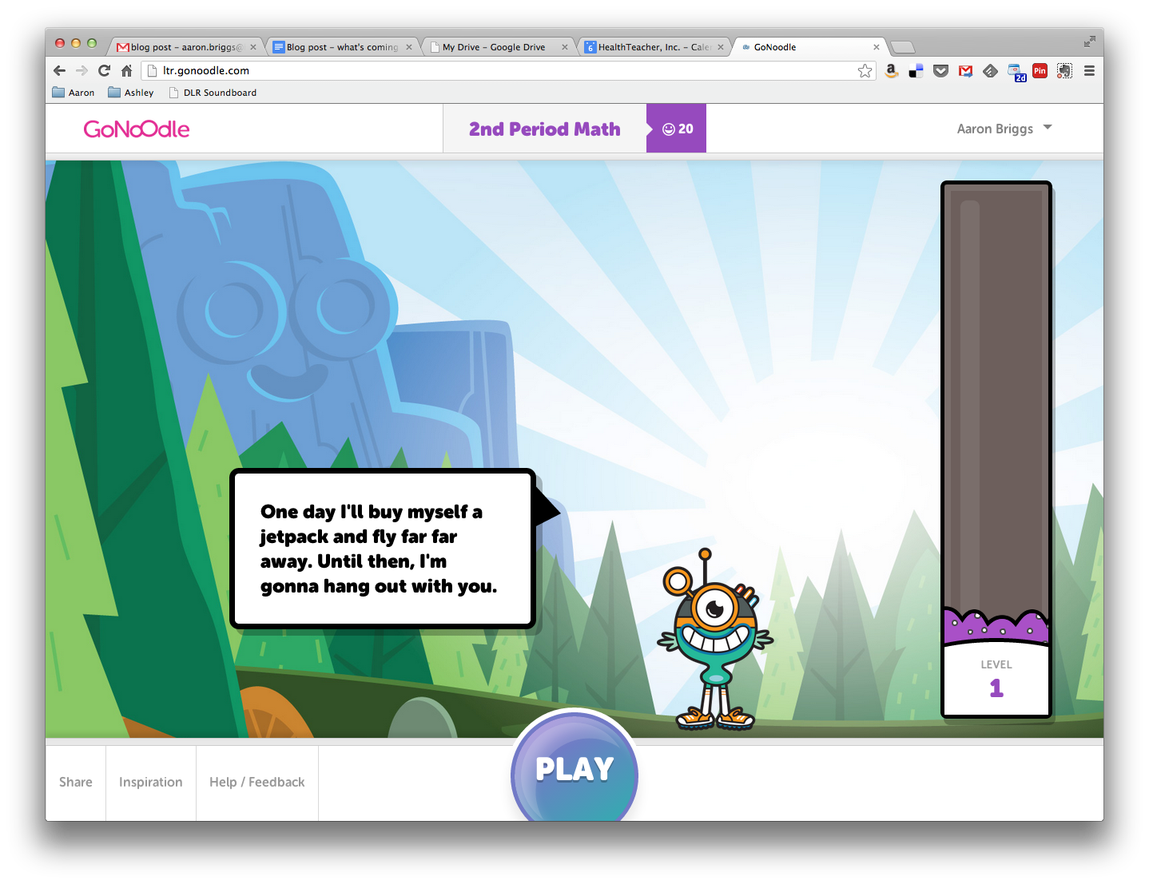
Exciting Additions to GoNoodle!
2. Champs! –Think of your Champ as a class mascot who grows as the classroom gains GoNoodle minutes.
The more GoNoodle brain breaks the class plays, the more their Champ will change.

Slide 49
Exciting Additions to GoNoodle!
3. More brain breaks –GoNoodle expanding the original brain breaks, starting with more races in Run With US!
Let’s stand up and
Brain Break!!
Notes:
Recommendations of GoNoodle activities for grade level specific-
K-1: WordSpell

Slide 50
When can YOU use a Brain Break?
Brainstorm with a partner when you can incorporate a Brain Break with your students into your instructional day, week, or unit.

Slide 51
Wrap Up & Exit Slip

Slide 52
For Next Time…
Try a GoNoodle Activity in your classroom.
Review the Mathematical Standards for your grade level.
We will spend time next month discussing what these will look like in your classroom

Slide 53
Exit Slip
Use a notecard on your table to complete one of the following sentence starters:
I am excited about…
Something I find challenging…
I would like more information about…
I really enjoyed…

